Slide 1
Adversarial Machine Learning
CS229
Tengyu Ma

Slide 2
Security Problems in Machine Learning
Adversarial training data
ML training data are often crowd-sourced or crawled from the web
Can malicious training data destroy the model, or create backdoors?
Adversarial test data
Adversarial test example can fool the classifier
Data privacy
If a model learned partially from data on your cell phone is made public, can others extract your personal information from the model?
Note: issues are not necessarily specific to modern ML; they existed before as well, but attracted less attention because ML didn’t work as well as it does today.

Slide 3
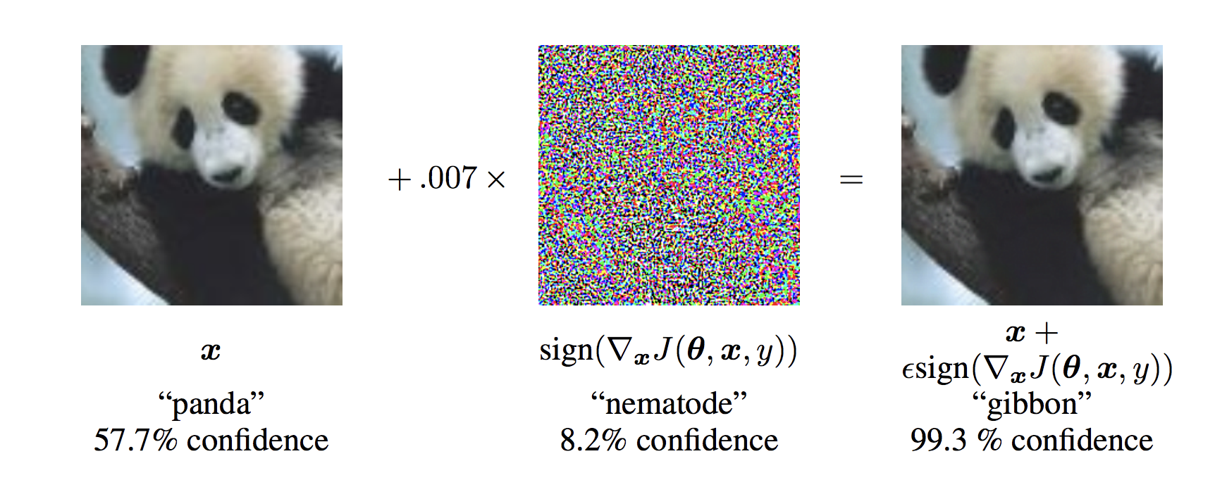
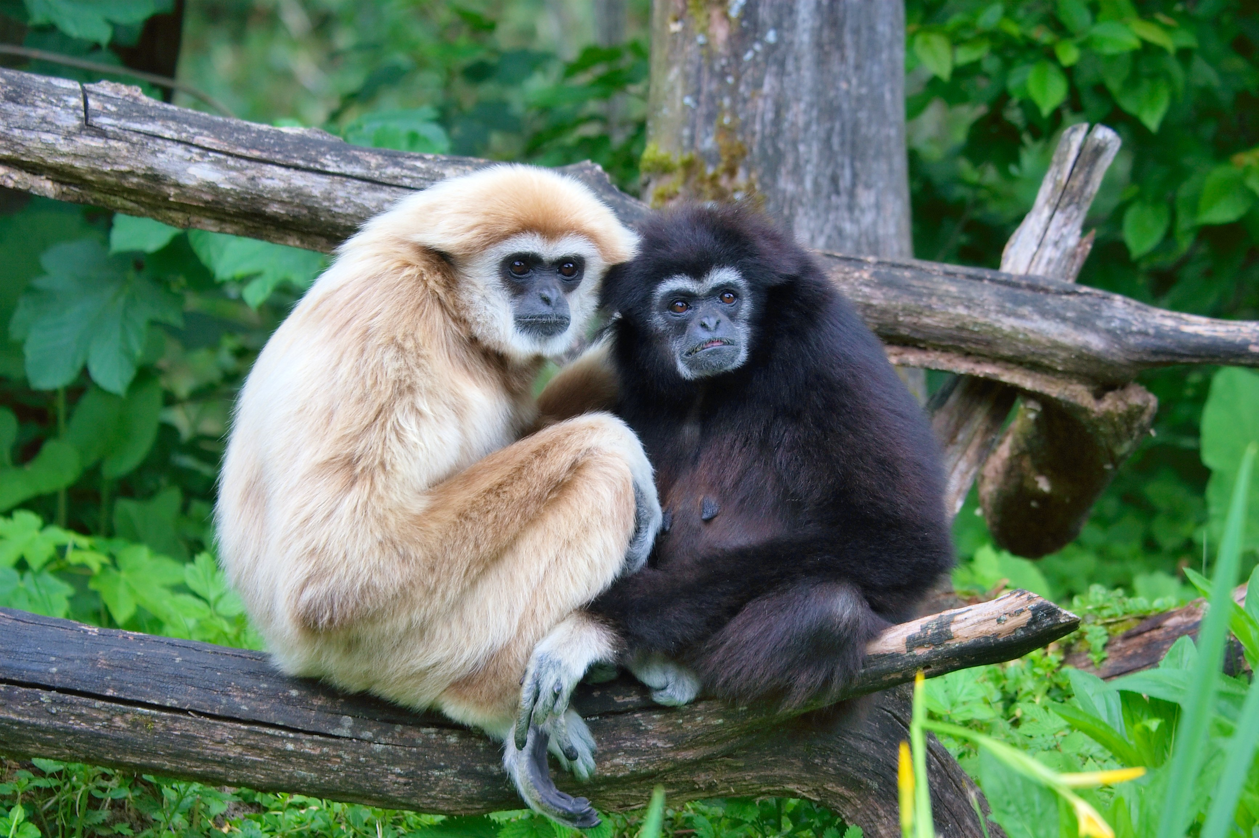
Adversarial Examples at Test Time
Image credit:
Above: Explaining And Harnessing Adversarial Examples. Ian J. Goodfellow, Jonathon Shlens & Christian Szegedy, 2015
Right: Wikipedia

Slide 4
3D Adversarial Examples
A turtle that is almost always classified as a rifle
[Synthesizing Robust Adversarial Examples Anish Athalye, Logan Engstrom, Andrew Ilyas, Kevin Kwok, 2018]
Video link: https://www.youtube.com/watch?v=YXy6oX1iNoA&feature=youtu.be

Slide 5
Formulation
Supervised learning with binary classification
$𝒳=ℝ^{d}, 𝒴=\{−1,1\}$
$f:𝒳→ℝ$
Training distributions $𝒟$, clean test distribution $𝒟$
Clean test accuracy: $\underset{\left(x,y\right)∼𝒟}{Pr}\left[1(yf\left(x\right)>0)\right]$
Attack/threat model: can perturb $x$ to get adversarial example $\hat{x}$
Commonly-studied attack model: $\hat{x}=x+Δ$ where $||Δ||_{∞}≤δ$
For small $δ$ (say $δ=0.1$ when coordinates of $x$ has average scale 1), such perturbation often does not affect human classification
Attacker’s goal: find $\hat{x}$ such that $yf\left(\hat{x}\right)<0$
Defender’s goal: maximize the robust test accuracy
$\underset{\left(x,y\right)∼𝒟}{Pr}\left[∀\hat{x}=x+Δ with ||Δ||_{∞}≤δ, s.t.,1(yf\left(\hat{x}\right)>0)\right]$

Slide 6
Attack Algorithms
Fast gradient sign method (FGSM)
Let $ℓ\left(\left(x,y\right);θ\right)$ be the loss function for training example $(x,y)$
Recall that small loss $⇒$ $f(x)$ is correct
Attack: $\hat{x}=x+δ⋅sign(∇_{x}ℓ\left(\left(x,y\right);θ\right))$
Projected gradient descent (PGD)
Solve the optimization problem below by projected gradient ascent
$\max{ℓ(\left(\hat{x},y\right);θ)}$
s.t. $||\hat{x}−x||_{∞}≤δ$

Slide 7
Defense: Adversarial Training
Idea: solving the min-max problem
$$argmin_{θ}\frac{1}{n} \sum_{i=1}^{n}{\max_{||Δ^{(i)}||_{∞}≤δ}{ℓ(\left(x^{\left(i\right)}+Δ^{\left(i\right)}, y^{\left(i\right)}\right);θ)}}$$
The parameters for which no adversarial examples increases the loss much
the “best” adversarial examples the attacker can find
Computational challenge:
the max cannot be evaluated exactly
heuristic: iteratively update ${Δ^{\left(i\right)}}^{′}s$ and $θ$
Am empirically strong defense; but hard to scale to large datasets due to computational overheads

